Slide 1
19CSE202 Database Mangement Systems
Relational Data Model

Slide 2
Flow of Topics
Fundamentals
Data Models
Relational Data Model
ER Model

Slide 3
Contents
Structure of Relational Databases
Keys
Schema Diagrams
Relational Query Languages
Relational Operations

Slide 4
Contents
Structure of Relational Databases
Keys
Schema Diagrams
Relational Query Languages
Relational Operations

Slide 5
Introduction
Relational data model is the commercial data model for todays applications.
It is simple and ease of use for programmer compared to other models.

Slide 6
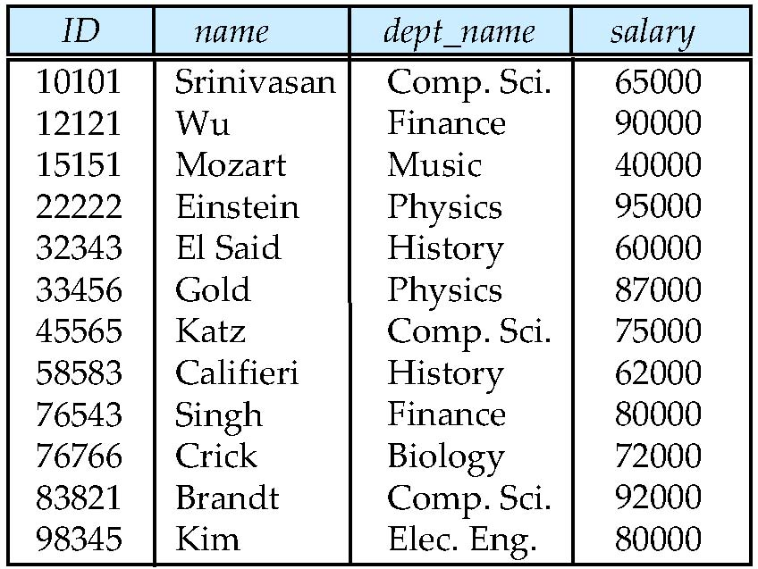
Structure of Relational Model
attributes
(or columns)
tuples
(or rows)
Relational DB is a collection of Tables.
Refer the Instructor Table.
There are four columns.
Each row is storing the values for ID, name, dept_name and salary of an Instructor.
Each row is identified by ID.

Slide 7
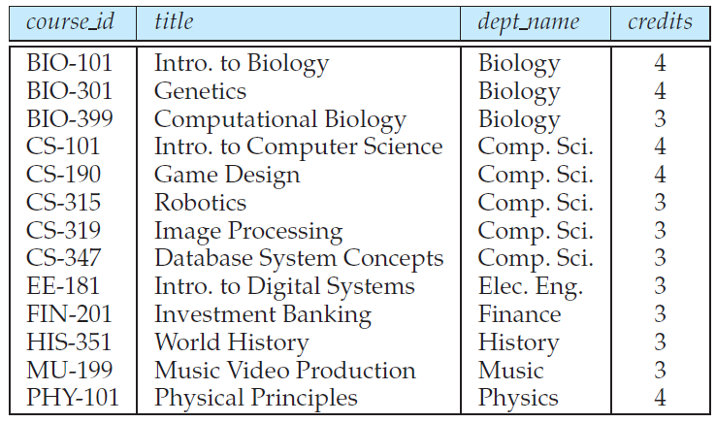
Another Example - Refer the Course Table.
There are four columns.
Each row is storing the values for course_id, title, dept_name and credits of a course.
Each course is identified by its course_id.

Slide 8

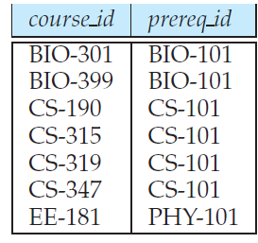
There are two columns.
In Each row, the second course is the prerequisite course for the first course.
Thus, each row indicates two courses are related.
Similar way, in Instructor table ID is related to name, dept_name and Salary of an instructor.
and in course table the course_ide is related to title, dept_name and credit.

Slide 9
Relational Model
In general, table represents relationship among set of values.
Table is a collection of relationships.
‘Table’ in Database design is similar to ‘relation’ in Mathematics…. Thus the term ‘Relational Model’.
In Mathematics …
Tuple is a sequence of values.
A relationship between n values is represented as and n-tuple of values.
In Relational Model …
Relation refers to a table.
Tuple refers to a row.
Attribute refers to a column.

Slide 10
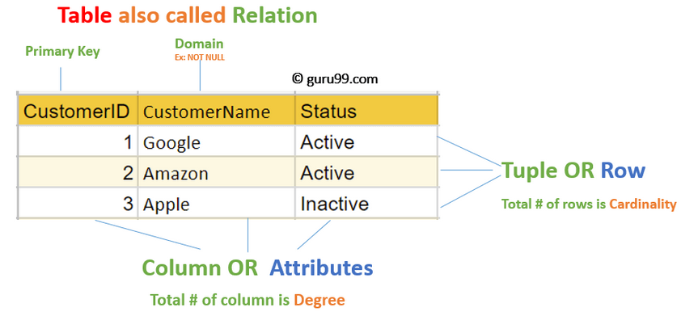

Slide 11
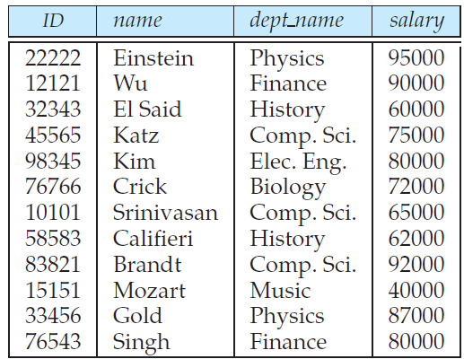
Relation Instance
Refer the Instructor relation instance, has 12 rows corresponding to 12 instructors.
The order in which the row are arranged is irrelevant. It can be sorted or unsorted.
Both the instances in right side are the same.

Slide 12
Concepts underlying Relational Model - domain
Domain of salary – Set of salary of instructors.
Domain of name – Set of names of instructors.
salary = {65000, 900000, 40000, 95000, 60000….80000}
Each element in the domain is a value for the attribute.
40000 is a value for the salary attribute.
The set of allowed values for each attribute is called the domain of the attribute.

Slide 13
Concepts underlying Relational Model - Atomic
Suppose we have ‘Phone-Number’ attribute in instructor relation, and allows multiple phone numbers for each instructor,
A sample domain of ‘Phone-Number’
={(0422-2685000,+91-8967563421),
(8934765478), (1278347865, 0433-783456)……}
First and third elements of this domain has two phone numbers, hence it is non-atomic domain.
For each relation (r), the domain of all attributes of r be atomic, if that is, indivisible.
salary = {65000, 900000, 40000, 95000, 60000….80000}
Is salary attribute atomic?
Answer: yes. Why?

Slide 14
Concepts underlying Relational Model - Atomic
A sample domain of ‘Phone-Number’
={0422-2685000, 0433-783456, +91-8967452312}
Is it Atomic domain?
Answer : No..
Why? – each phone number is divisible – country code, city code and phone number.
A sample domain of ‘Phone-Number’
={3456789023, 3948576819, 7829345678}
Is it Atomic domain?
Answer: Yes
Why? – each element in this domain is single value ie., indivisible.

Slide 15
Concepts underlying Relational Model - ‘null’
The special value null is a member of every domain. Indicated that the value is “unknown” or does not exist.
The null value causes complications at the time of accessing the data from database, hence use of null to be restricted.
If an instructor does not have phone, the value for his phone-number attributed to be stored ‘null’

Slide 16
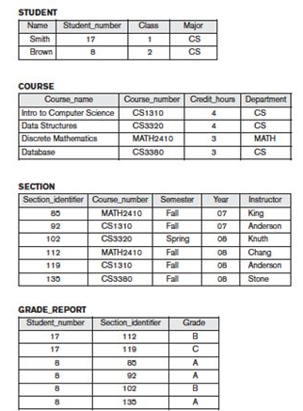
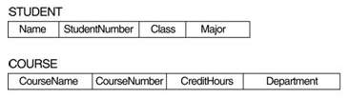

Concepts underlying Relational Model -
Database schema Vs Database Instance.
Database Instance
Database Schema – the logical design of the database.
Database Instance – the content of the database at an instance of time.
Database Schema

Slide 17





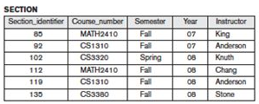
Concepts underlying Relational Model -
relation Schema Vs relation instance
Relation Schemas
Relation Instance
In General relation schema contains the list of attributes and their domains.
Eg Student {Name: String; StudentNumber: String; Age: integer}

Slide 18
Concepts underlying Relational Model -
relation schema & instance…
int marks [5]; ----- Schema
Marks[78, 93, 90, 89, 83] ----- instance
Instance – changes.
Schema – does not.

Slide 19
Let us proceed further with University Database

Slide 20
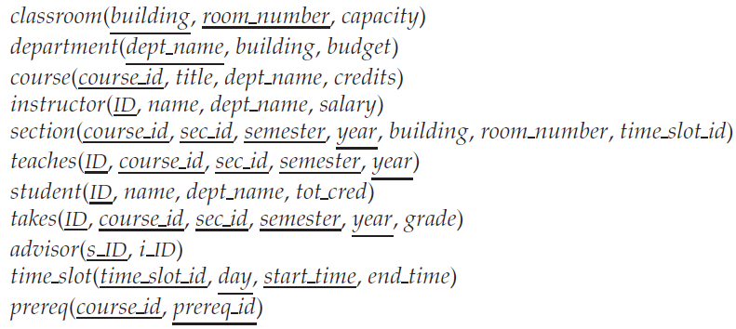
University Database – Relation Schemas

Slide 21
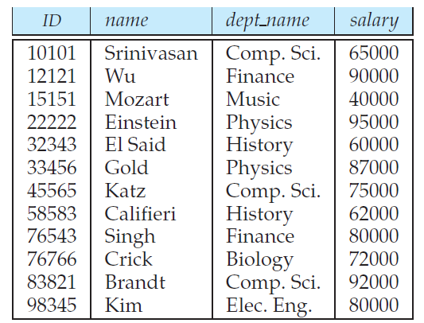
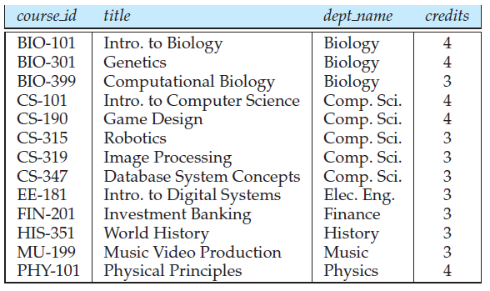
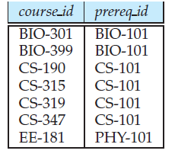
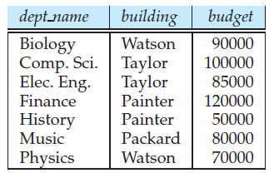
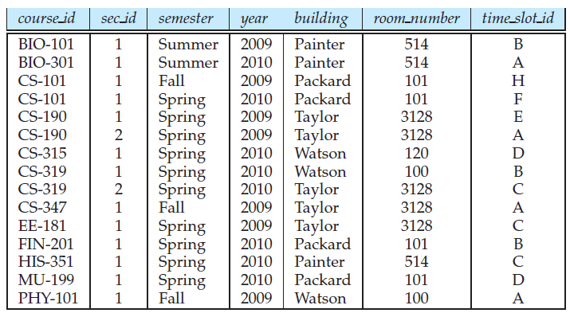
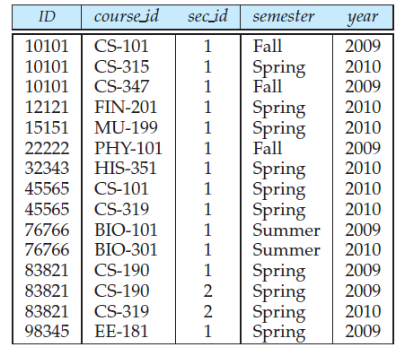
University Database – Relation Instances
instructor
course
prerequisite
department
Instructor is related to department by dept_name attribute.
Instructor is related to sections by course_id, sec_id and semester and the association is stored in a new relation teaches.
section
teaches
…

Slide 22
Relation Schema and Instance
If A₁, A₂, …, A_{n} are attributes
R = (A₁, A₂, …, A_{n} ) is a relation schema
Example:
instructor = (ID, name, dept_name, salary)
Formally, given sets D₁, D₂, …. D_{n} which are the domains of A₁, A₂, …, A_{n} , a relation r is a subset of D₁ x D₂ x … x D_{n.}
Thus, a relation is a set of n-tuples (a₁, a₂, …, a_{n}) where each a_{i} ∈ D_{i}

Slide 23
Contents
Structure of Relational Databases
Keys
Schema Diagrams
Relational Query Languages
Relational Operations

Slide 24
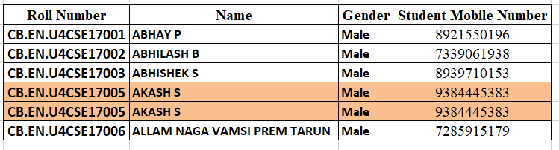
Keys
No two relations in a relation is allowed to have same values in all the attributes.
Tuples with in a given relation to be distinguished, by the values of the attributes.
Super Keys, Candidate Key, Primary Key, Foreign Key

Slide 25

Superkey
Let K ⊆ R
K is a superkey of R if values for K are sufficient to identify a unique tuple of each possible relation r(R)
Example: {ID} and {ID, name} are both superkeys of instructor.
{name} is not a superkey, because more instructors may have same name.

Slide 26
Candidate Keys
A superkey may have extraneous attribute.
Eg. In {ID, name}, name is extraneous.
Superkey for which no proper subset is a superkey is the candidate key. .. Or
Superkey K is a candidate key if K is minimal Example: {ID} is a candidate key for Instructor, but not {ID, name}.
There can be many possible candidate keys for a relation
Eg. {ID} and {name, dept_name} for instructor.

Slide 27
Primary keys.
Several distinct set of attributes could serve as candidate keys.
The candidate key which is primarily chosen by the database designer is the primary key.
{ID} in instructor is the primary key.

Slide 28
Primary Keys
Must be chose with care.
Their attribute values are never or very rarely changed.
Eg. RollNumber.
The primary key of a relation to be listed before other attributes.
Refer the department relation.

Slide 29
Foreign Keys
A relation, say r₁, may include among its attributed the primary key of another relation, say r₂.
This attribute is called as foreign key from r₁, referencing to r_{2.}
The relation r₁ is called as the referencing relation and r₂ is called the referenced relation.
The foreign key forms a dependency between r₁ and r₂.
Eg. dept_name attribute, from instructor relation to department relation.

Slide 30
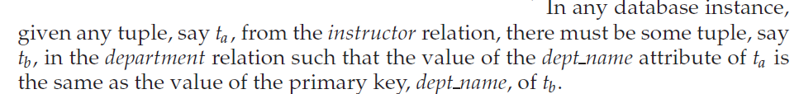

Slide 31
Referential Integrity Constraints
section
teaches
If a section exists for a course, it must be taught by at least one instructor. However, it could possibly be taught by more than one instructor…..This is a constraint.
To enforce above constraint, we require that if a particular (course_id, sec_id, semester, year) combination appears in section, then the same combination must appears in teaches. ( Looks Like Foreign key from section to teaches ).. However this set of value is not form a primary key for teaches, since more than one instructor may teach one such section. So we can not set foreign key from section to teaches (…however we can define from teaches to section … why?)

Slide 32
Referential Integrity Constraints
The constraint from section to teaches is an example of a referential integrity constraint.
A referential integrity constraint requires that the value appearing in the specified attributes of any tuple in the referencing relation also appears in specified attributes of at least one tuple in the referenced relation.
Example: (Refer relations in the previous slide)
section Referencing teaches by (course_id, sec_id, semester, year)
section is referencing relation
teaches is referenced relation

Slide 33
Contents
Structure of Relational Databases
Keys
Schema Diagrams
Relational Query Languages
Relational Operations

Slide 34
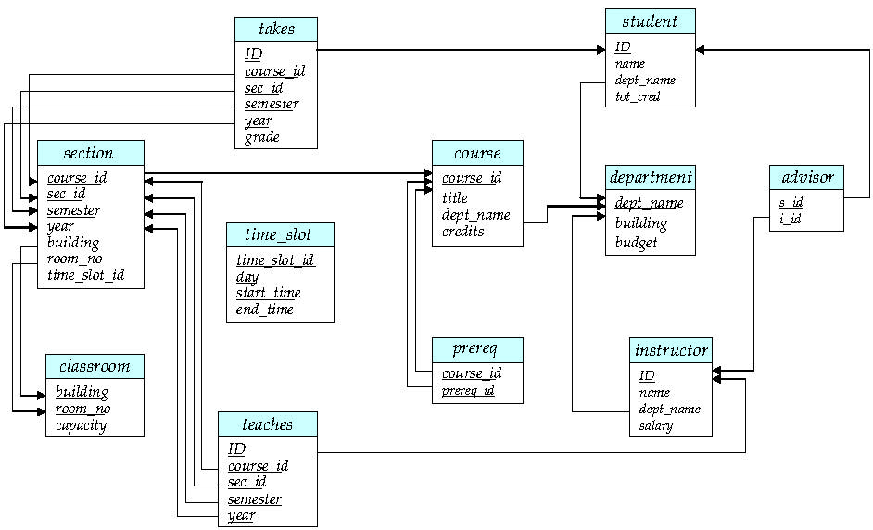
Schema Diagram
The database schema and its keys can be visualized in Schema Diagram.

Slide 35
Contents
Structure of Relational Databases
Keys
Schema Diagrams
Relational Query Languages
Relational Operations

Slide 36
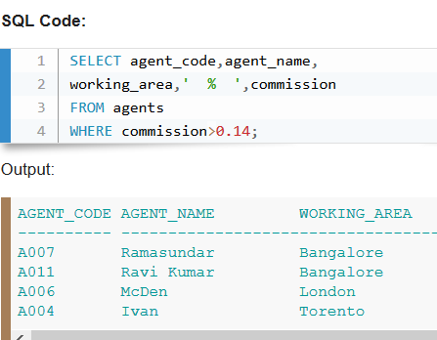
Relational Query Language
A query language is a language in which a user requests information from the database.
They are on a level higher than that of standard programming languages.
An example

Slide 37
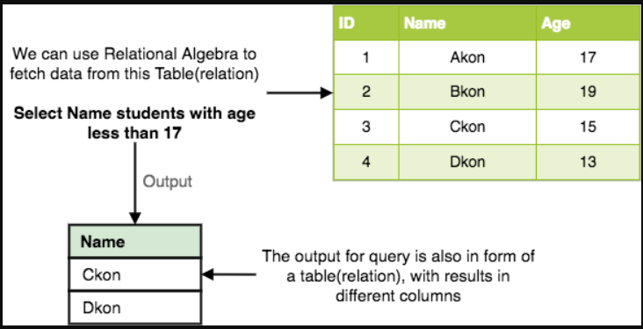
Relational Query Language
Two Categories
Procedural Languages non-procedural language
User instructs the system to perform the user describes the desired results
a sequence of operations on the database without giving a specific procedure
to compute desired result. for obtaining it.
* Query languages in practise use both the approaches.
Relational algebra is a procedural query language, which takes instances of relations as input and yields instances of relations as output. It uses operators to perform queries.

Slide 38
Contents
Structure of Relational Databases
Keys
Schema Diagrams
Relational Query Languages
Relational Operations

Slide 39
Relational Operations
The procedural query languages provide a set of operations that can be applied one or more relations.
These operations have desired properties.
These operations can be combined in a modular way.
Common operations – Selection, Projection, Union, Difference, Intersection and Join (natural join and Cartesian Product)

Slide 40
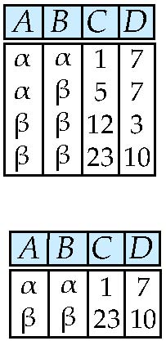
Select Operation – selection of rows (tuples)
Relation r
σ_{A=B ^ D > 5} (r)

Slide 41
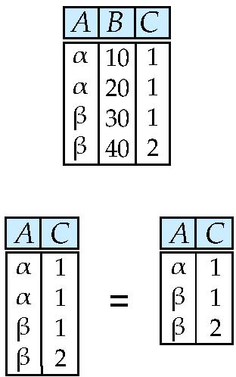
Project Operation – selection of columns (Attributes)
Relation r:
∏_{A,C} (r)

Slide 42
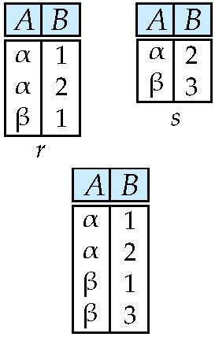
Union of two relations
Relations r, s:
r ∪ s:

Slide 43
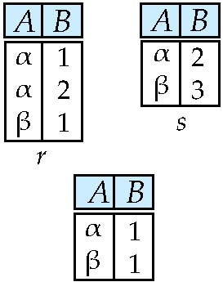
Set difference of two relations
Relations r, s:
r – s:

Slide 44
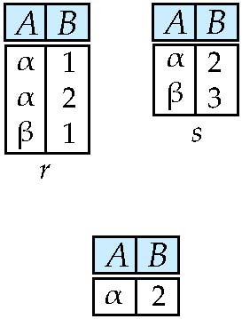
Set intersection of two relations
Relation r, s:
r ∩ s
Note: r ∩ s = r – (r – s)

Slide 45
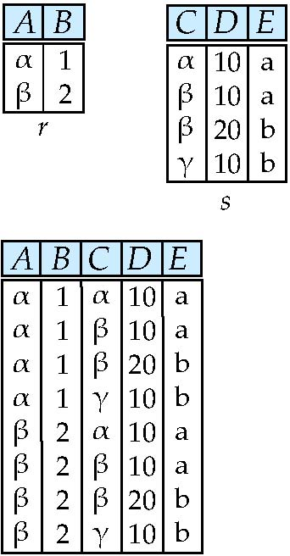
joining two relations -- Cartesian-product
Relations r, s:
r x s:

Slide 46
Cartesian-product – naming issue
B
Relations r, s:
r.B
s.B
r x s:

Slide 47
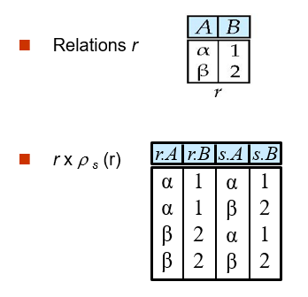
Renaming a Table
Allows us to refer to a relation, (say E) by more than one name.
ρ _{x} (E)
returns the expression E under the name X

Slide 48
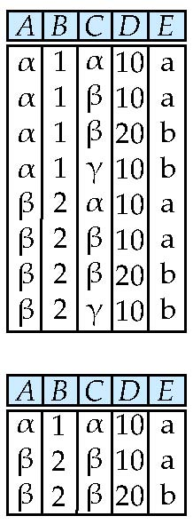
Composition of Operations
Can build expressions using multiple operations
Example: σ_{A=C} (r x s)
r x s
σ_{A=C} (r x s)

Slide 49
Joining two relations – Natural Join
Let r and s be relations on schemas R and S respectively. Then, the “natural join” of relations R and S is a relation on schema R ∪ S obtained as follows:
Consider each pair of tuples t_{r} from r and t_{s} from s.
If t_{r} and t_{s} have the same value on each of the attributes in R ∩ S, add a tuple t to the result, where
t has the same value as t_{r} on r
t has the same value as t_{s} on s

Slide 50
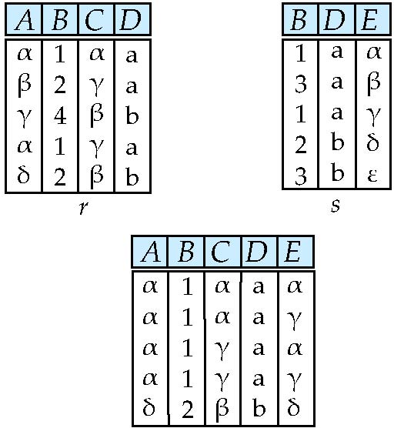
Natural Join Example
Relations r, s:
Natural Join
r s
∏ _{A, r.B, C, r.D, E} (σ _{r.B = s.B ˄ r.D = s.D} (r x s)))

Slide 51
Summary of Relational Algebra Operators
Symbol (Name) Example of Use
σ
(Selection) ^{σ} salary > = 85000 ^{(instructor)}
Return rows of the input relation that satisfy the predicate.
Π
(Projection) ^{Π} ID, salary ^{(instructor)}
Output specified attributes from all rows of the input relation. Remove duplicate tuples from the output.
x
(Cartesian Product) instructor x department
Output pairs of rows from the two input relations that have the same value on all attributes that have the same name.
∪
(Union) ^{Π} name ^{(instructor) ∪ Π} name ^{(student)}
Output the union of tuples from the two input relations.
-
(Set Difference) ^{Π} name ^{(instructor)} ^{-- Π} name ^{(student)}
Output the set difference of tuples from the two input relations.
⋈
(Natural Join) instructor ⋈ department
Output pairs of rows from the two input relations that have the same value on all attributes that have the same name.

Slide 52
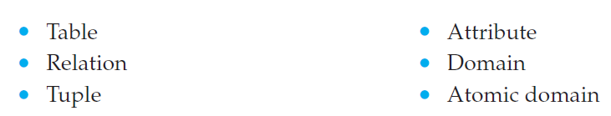
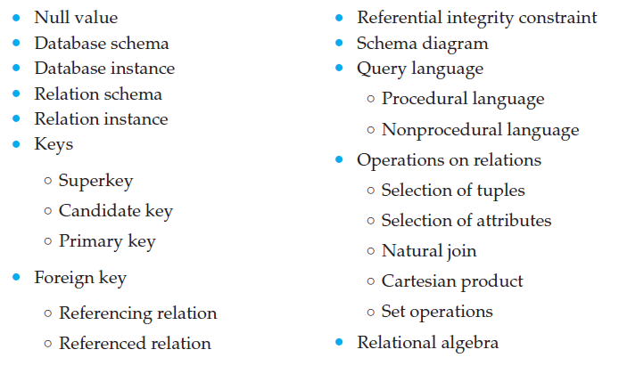
Review Terms

